Slide 1
CIS 5300: Haiku Generation
Akriti Gupta
Bhumika Singhal
Namita Shukla
Smruti Chourasia
Notes:
Good morning everyone! We are second year Masters students and today, we’ll be talking about our NLP project on Haiku Generation which we found really exciting.

Slide 2
Problem Statement

Slide 3
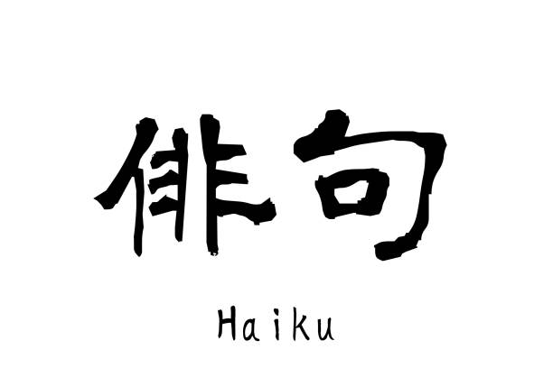
Problem Statement
What are Haikus?
Why is Haiku Generation so hard?
Short Japanese poems
Consisting of three lines
Fixed syllable scheme of (5-7-5)
Dearth of cleaned datasets
High structural constraint
Data inconsistency due to translation from Japanese to English
Notes:
Haiku is a short poem with an exceptionally well-defined structure.
Traditional compositions of Haikus consist of three lines following a 5, 7, 5 syllable pattern, typically containing a kigo, which is a seasonal reference, and often a kireji, also known as metrical pause. Such characteristics of Haiku make their automatic generation an extremely interesting Computational Linguistics task due to this strictly constrained nature. Also, since this is a text generation task, its evaluation is subjective in nature adding on to the complexity of the task.
We picked this because of its complex and creative nature of the problem statement that compelled us to take it up as our final project.

Slide 4
Dataset and its formatting

Slide 5
Dataset:
Final Dataset Size:
Source | Size
Haiku dataset from Tempes Libres (Twitter hashtag “twaiku”) | 140K
Sam Ballas’ PoetRNN corpus (dailyhaiku.org) | 8000
Herval Freire’s Haikuzao corpus | 6000
Kaggle | 11269
Train Set | 123524
Development Set | 30882
80% of the total data follows the Haiku 5-7-5 syllable structure.
Notes:
Dataset
Haikus dataset are generally tough to write, hence tough to find. However, for a generative task we need abundant amount of data for the model to be able to learn the constrained essence of haikus. Hence we resorted to combining datasets from different sources - after applying appropriate pre processing to each.
We combine the different datasets into a final Pandas dataframe; the first 3 columns refer to the three sentences of the haiku, we also store the source of the dataset. Our next feature is count of syllables in each line since our main moto here is to ensure that the model learns the 5-7-5 structure of haiku.

Slide 6
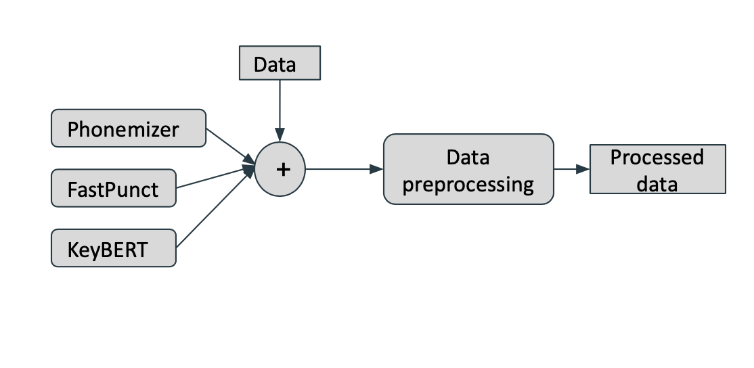
Dataset Formatting:
Evaluation Metric:
GRUEN + Mean Syllable Count
Cleaning (Subset only alphanumeric chars)
FastPunct - Punctuation, Capitalization, etc.
Phonemizer - Extracting phonemes
KeyBERT - Topic Extraction
GRAMMAR
NON REDUNDANCY
FOCUS
STRUCTURE
COHERENCE
Notes:
To improve the structure of the poems and have uniformity we use:
FastPunct to add punctuation and capitalization to text
splitting the text into phonemes using Phonemizer
topics of text extracted from KeyBERT
Although BLEU works well for assessing text quality based on the expected result, it doesn’t help determine the quality of creative writing. To date, these metrics have focused almost exclusively on the content selection aspect of the system output, ignoring the linguistic quality aspect altogether. We bridge this gap by using GRUEN which typically evaluates: Grammaticality, non-Redundancy, focus, structure and coherence of generated text.
The final linguistic quality score is a linear combination of the above four scores:
GRUEN-Score = grammatically + non-redundancy + focus + structure and is on a scale of 0 to 1. -Mean of the syllables across each line

Slide 7
Previous Work

Slide 8
Past Work
Character Level Recurrent CNNs and Sequence GANs
Haikoo
Uses Rinna (chatbot) query log
Scraped LOTS of haikus from the net
Obtained over 50 million access in a month
GPT2 based transformer model
Outperforms SOTA
Generalizes quality of haikus
Adopts a plug and play language model
Notes:
>Emotional chatbot Rianna to share the culture of Haiku among young people.
> They experimented using minimal vanilla RNN for learning & character level neural networks like Character level RCNNs and Sequence Generative Adversarial Networks.
> Rinna obtain more than 50 million users in a few months.
> Haikoo:
– Used GPT-2 and Plug and Play Language Model with generation with bag-of-words approach for highly focused control over the output. This outperforms previous SOTA neural network.
– The metrics used to evaluate the generated haikus were “Perplexity”,”Sensicality” , ”Wisdom” and ”Overall Quality” assessment by Amazon MT workers

Slide 9
Simple Baseline: SpaCy Matcher

Slide 10
Simple Baseline: SpaCy Matcher
English words and corresponding POS tags were learnt using Matcher module of SpaCy to generate our Model.
Model was used to randomly generated words for a given syllable structure i.e. 5-7-5 and given POS tag.
Simple guessing technique.
Results: SpaCy Matcher
GRUEN Score | Syllable structure statistics
0.29 (Mean) | Line 1 | 4.9 (Mean) | 5 (Median)
0.26 (Median) | Line 2 | 6.8 (Mean) | 7 (Median)
0.79 (Max) | Line 3 | 4.9 (Mean) | 5 (Median)
Notes:
Methodology - SpaCy Matcher
SpaCy is a NLP open-source library. It is used in designing systems for information extraction or natural
language understanding systems.
1. Our approach involved learning the English words and their corresponding POS(Part-Of-Speech) tags
using the Matcher module of SpaCy.
2. Then we defined the syllable(Haiku) structure i.e. 5-7-5 and the POS tag that we expect for each word
in the Haiku.
3. Following this, we randomly generated words from our dataset that corresponded to the pattern specified.
4. This model is a simple guessing technique.It can be seen that there is no meaning of the Haikus generated and is made up of the most frequent words in the dataset. For example - randomly mixing sentences to generate a haiku with the required syllable structure.
5. Their quality is low, though their syllable structure is correct which is expected as we specified the pattern.
Results
We generated about 1500 poems -
1.GRUEN score statistics The average GRUEN score was 0.29 - with a median of 0.26 showing an almost consistent distribution.
The max GRUEN score achieved was 0.79 for the poems generated. Hence the quality of the poems generated are not great.
2.Syllable structure statistics The average number of syllables across line 1:4.9, line 2: 6.8 and line 3: 4.9 although the median of the distribution is line 1: 5, line 2: 7 and line 3: 5 - showing the generated data has learnt the structure of the data. This is simply because the Matcher module is able to generate based on the given POS tags and poems.

Slide 11
SpaCy Matcher Sample Haikus
Sample Haikus | Meter | GRUEN Quality
Groggy mists submerge Slowly seasons salty seas Last sounds of nature | [5,7,5] | 0.398
On a dreary shelf Slowly fade into orange Hard shapes of fish | [5,7,5] | 0.3441
Pale afternoon sun With changes and mixtures Whispers and screaming | [5,7,5] | 0.2698

Slide 12
Strong Baseline: CharRNN

Slide 13
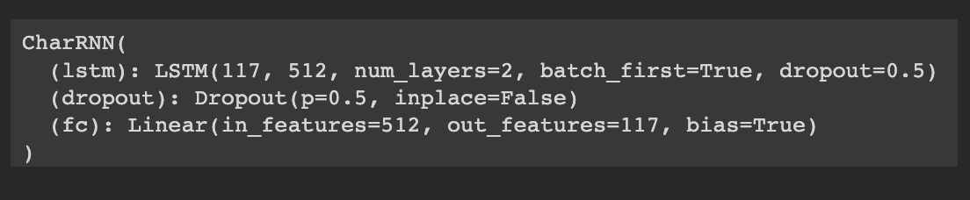
Strong Baseline: Character RNN
Haikus (character by character) are feeded into the model without any additional metadata (syllable structure, topic of haiku).
A token dictionary and Map of character to integer was created. We one hot encoded the data to represent characters.
A sampler (top-k samples) which takes in a character as a seed and generates next characters was used
Results: Character RNN
GRUEN Score | Syllable structure statistics
0.34 (Mean) | Line 1 | 7.5 (Mean) | 5 (Median)
0.28 (Median) | Line 2 | 8.7 (Mean) | 7 (Median)
0.88 (Max) | Line 3 | 8.0 (Mean) | 6 (Median)
Notes:
Methodology - Character RNN
In a gist, our character level RNN reads haikus as a series of characters - outputting a prediction and “hidden state” at each step, feeding its previous hidden state into each next step.
Step by step approach:
1. First step was data preprocessing - only the haikus (character by character) are feeded into the model without any additional metadata (such as syllable structure, topic of haiku,etc.).
2. Our neural network does not understand text so we have to convert our text data to integer. For this purpose we create a token dictionary and map character to integer and vice versa. In addition to this, we one hot encode the data to represent characters.
3. The parameters that determine the batch size are -
Batch Size, which is the number of samples we send to the model at a time.
Sequence Length is the length of the sequence of input data.
4. Now finally, we create a class called CharRNN. Here we use LSTM as our RNN model.
Hyperparameters for the model and training are as follows:
Number of LSTM layers = 2
Number of epochs = 30.
Dropout = 0.5
Learning rate = 0.001
Batch size = 128
Sequence Length as 100
Gradient clipping = 5
Adam Optimizer
Cross Entropy Loss as criterion
5. After training, we define a sampler (top-k samples with k =2) which takes in a character as a seed and generates next characters.
7. The generated output is stored in 3 columns in a csv where each column corresponds to each sentence in the Haiku. For evaluation, we use the GRUEN script.
8. The quality of generated poems is better than the simple baseline although since this learns poems character to character basis the syllable structure is on the weaker side.
Results
We generated about 1458 poems -
1.GRUEN score statistics: The average GRUEN score was 0.34 - with a median of 0.28 showing an almost consistent distribution. The max GRUEN score achieved was 0.88 for the poems generated.
2.Syllable structure statistics The average number of syllables across line 1:7.5, line 2:8.7 and line 3: 8.0 although the median of the distribution is line 1: 5, line 2: 7 and line 3: 6 - showing the generated data has some anomalies although given the input haiku the model was able to learn some structure.
Though 25%+ poems are unable to follow the structure.The 75th percentile is 10-10-10 syllable structure which states that the architecture has less than required information about the syllable structure.

Slide 14
CharRNN Sample Haikus
Sample Haikus | Meter | GRUEN Quality
Through swaying green arch Lucidity builds quickly Autumn may bring hope | [7, 8, 5] | 0.287
Angry swollen spots Reflective yet transparent of a thousand suns | [4, 7, 8] | 0.327
Hungry this morning Nature reclaimed our old Rapid eye movement | [7, 6, 8] | 0.298

Slide 15
Extending Strong Baseline: Char RNN + Syllables

Slide 16
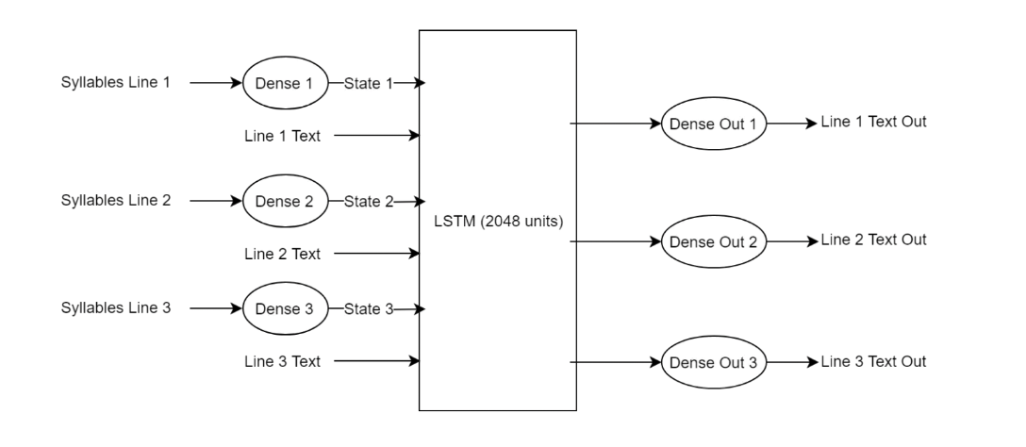
Strong Baseline: Character RNN - Extension
Added syllable structure information to capture the structural essence of Haikus
Hidden Dimension Representation was formed by passing syllables information(number of syllables) for each line through a dense layer.
This was then added into the hidden state and the cell state of the LSTM network.
We then perform the character-level generation of the line using the updated states.
Results: Character RNN - Extension
GRUEN Score | Syllable structure statistics
0.348 (Mean) | Line 1 | 4.96 (Mean) | 5 (Median)
0.31 (Median) | Line 2 | 7.56 (Mean) | 7 (Median)
0.88 (Max) | Line 3 | 6.2 (Mean) | 6 (Median)
Notes:
Here the idea was to extend the CharRNN network defined before by adding the syllable structure information into it. For each line of the poem - we do a character level generation of the line - along with that we pass the syllable information by passing number of syllable in that line through a dense layer to form a hidden dimesnion representation and adding it into the hidden state and cell state of the LSTM network.Extending our explanation of CharRNN we one hot encode the text line wise in each poem. In a loop of 3 we pass the tensors into our lstms - add the dense representation of the syllable count according to the line number - and we get the output for each line. The preliminary results are about average GRUEN score of 0.348 - with a median of 0.31 - this has not improved a little from CharRNN model. Although the main motto was to improve the structure of the poem and we can observed that the average number of syllables across line 1: 4.96, line 2: 7.56 and line 3: 6.2 although the median of the distribution is line 1: 5, line 2: 7 and line 3: 6 - showing the generated data learnt the structure of the poems in a better way

Slide 17
CharRNN - Extension Sample Haikus
Sample Haikus | Meter | GRUEN Quality
Spring is a long time Apart, I still miss you, my Days spring is my love | [5, 7, 5] | 0.3053
The world is just meat And you are the stomach who Soars like butterflies? | [5, 7, 5] | 0.3361
I feel a little Bit like a butterflies ass This year is madness | [5, 7, 5] | 0.343

Slide 18
Fine Tuned GPT-J: Deep Haiku

Slide 19
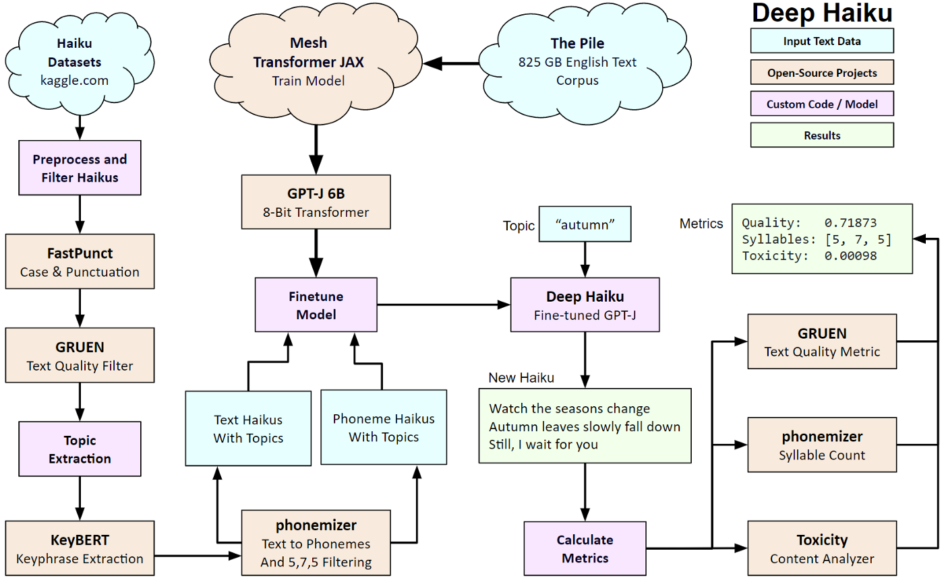
Fine-tuned GPT-J Architecture

Slide 20
Fine tuned GPT-J - Deep Haiku
Fine-tuned using LoRa on four tasks:
Generate a Haiku for a given topic using text
Generate a Haiku for a given topic using phonemes
Translate a Haiku from text to phonemes
Translate a Haiku from phonemes to text
Results: GPT-J
GRUEN Score | Syllable structure statistics
0.54 (Mean) | Line 1 | 4.96 (Mean) | 5 (Median)
0.55 (Median) | Line 2 | 7.05 (Mean) | 7 (Median)
0.87 (Max) | Line 3 | 5.10 (Mean) | 5 (Median)
Notes:
We propose Low-Rank Adaptation, or LoRA, which freezes the pretrained model weights and injects trainable rank decomposition matrices into each layer of the Transformer architecture, greatly reducing the number of trainable parameters for downstream tasks. — Edward Hu, et al.
https://towardsdatascience.com/deep-haiku-teaching-gpt-j-to-compose-with-syllable-patterns-5234bca9701

Slide 21
GPT-J Sample Haikus
Sample Haikus | Meter | GRUEN Quality
Be a part of the Ritual of nature in This beautiful park. | [5,7,5] | 0.7826
There is a certain Beauty to nature that I Can’t find in people | [5,7,5] | 0.7086
I was sleeping good And I woke up to the scent Of burning autumn | [5,7,5] | 0.8120

Slide 22
Conclusion

Slide 23
Conclusion : Model Comparison
Model | Mean GRUEN Score | Mean Syllable Structure
SpaCy | 0.2928 | 4.91, 6.78, 4.92
CharRNN | 0.339 | 7.58, 8.71, 8.03
CharRNN + syllable | 0.348 | 4.96, 7.56, 6.2
Fine Tuned GPT-J | 0.544 | 4.96, 7.05, 5.10

Slide 24
Future Scope
Improve structure by adding structure based loss along with cross entropy used for characters to ensure model penalizes unconstrained structure as well.
Improve the performance of GPT-J model using -
data augmentation to improve the quality and quantity of the training set
constraint of toxicity level in the generated text
Implement style transfer from one haiku to another.

Slide 25
Thank You

